Slide 1
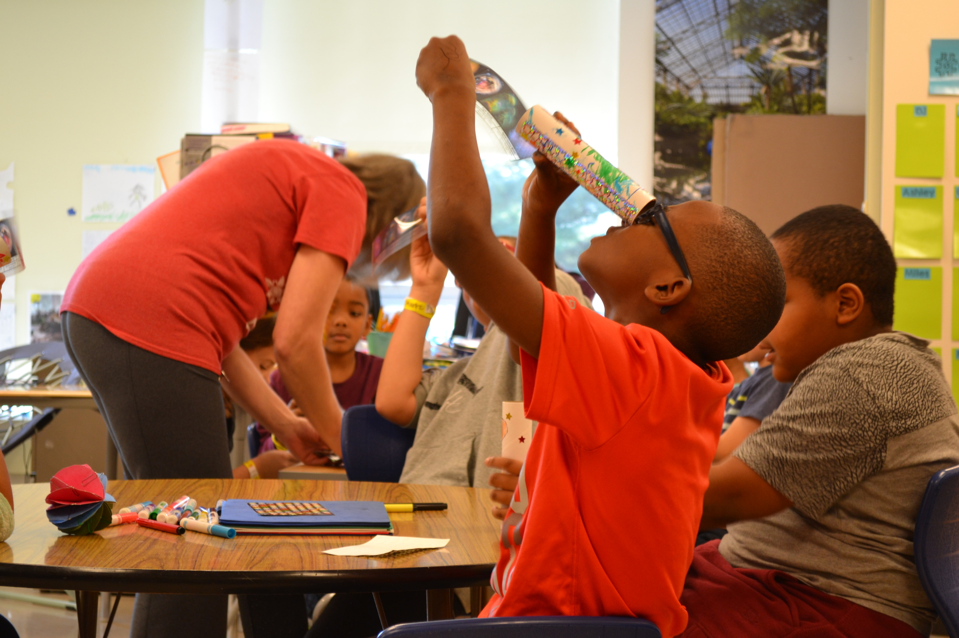
Building community partnerships to provide real-world context
Heather Sherman
Battelle
STEM Designation Overview

Slide 2
Learning Objectives
Review the relationship between culture, curriculum and connections to the community to facilitate high-quality STEM/STEAM education
Define authentic partnerships
Find partners in your local community
Incorporate partners into learning experiences for students

Slide 3
Format for today
Review STEM Quality Model (highlights)
Panel discussion
Please participate in the discussion
Contribute to the collaborative note-catcher
Panelists:
Chad Miller, Shenandoah Elementary Principal
Dr. Jennifer Theis, Bigelow Hill Intermediate School Principal
Dr. Thomie Timmons, Deeper Learning Coordinator, Reynoldsburg City Schools

Slide 4
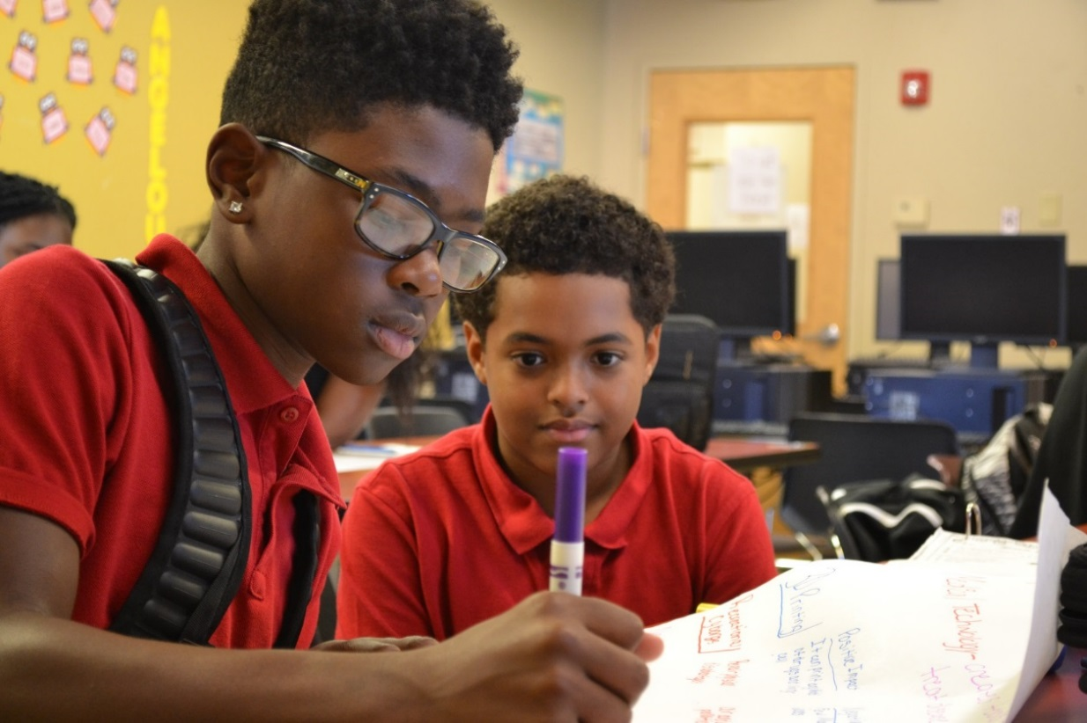
STEM/STEAM Schools
Culture of innovation
Inquiry-based, hands-on instruction throughout all content
STEM/STEAM partnerships
Leader and teacher development
Strong connection to institutes of higher education, particularly at secondary level
Curriculum team – with community experts including industry partners and experts in arts integration for STEAM
4

Slide 5
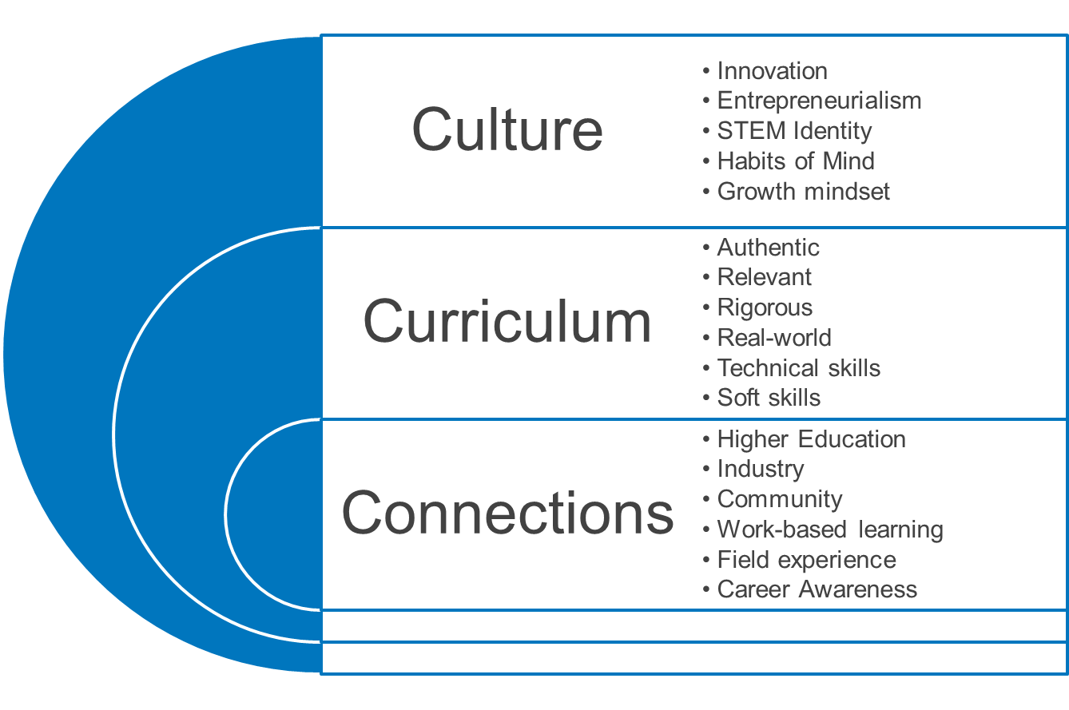
STEM/STEAM is for ALL students

Slide 6
Domain III: Pathways to Success in Careers
Connections: creating connections to the community creates context for classroom learning!
Helps answer the question, “when are we ever going to use this in the real world!”
Career exploration must be demonstrated by every school – even early elementary

Slide 7
Essential Criterion 10: STEM and STEAM schools exhibit curricular connections with business and industry, providing opportunities and access for success in college and career.
Essential Criterion 11: STEM and STEAM schools exhibit STEM-rich formal and informal experiences with the community that are personally relevant to the student.
Essential Criterion 12: STEM and STEAM schools exhibit collaborative partnerships with business, industry, arts, and higher education that provide and enhance opportunities for practical and real-world experience.

Slide 8
What makes a good partnership?
Mutually beneficial
Locally based
Organization/resource that acts as an advocate for your school
Opportunity to showcase what you are doing within your school
Engagement and investment – time, talent and treasure

Slide 9
Types of Partners

Slide 10
Benefits of partnering with outside organizations
Workforce development
Real world experiences
Authentic audiences

Slide 11
Panel Discussion
Note-catcher link

Slide 12
Designation Timeline
November 15: FY23 Application posted
December 15: Complete this survey to inform the Ohio Department of Education and the Ohio STEM Learning Network on your intent to apply and if technical assistance will be pursued.
January 19: Submit a rough draft of the application/portfolio to the Ohio STEM Learning Network for technical assistance. Email rough drafts to osln@battelle.org. You will receive feedback on your draft application in time to make changes prior to the final submission to Ohio Department of Education.
February 24: Final applications due to the Ohio Department of Education by 5 p.m.
March-April 2022: After a preliminary review from the Ohio STEM Learning Network, site visits to selected schools will be conducted during the spring (March/April). A school may also request a site visit when submitting their application.
April 2022: Applicants will be notified of the Ohio STEM Learning Network’s recommendation.
May 2022: The Ohio STEM committee will vote on designated schools.

