Slide 1
Assessment Authoring System
Scott Bryant Office of Assessment
August 2023

Slide 2
Assessment Authoring System
As part of ODE’s new contract with Cambium, it included creation and rollout of a new assessment authoring system
Assessment Authoring allows for teachers and districts to build tests from a bank of thousands of test items
Available to districts and schools as of August 1, AASCD will be rolled out September 11

Slide 3
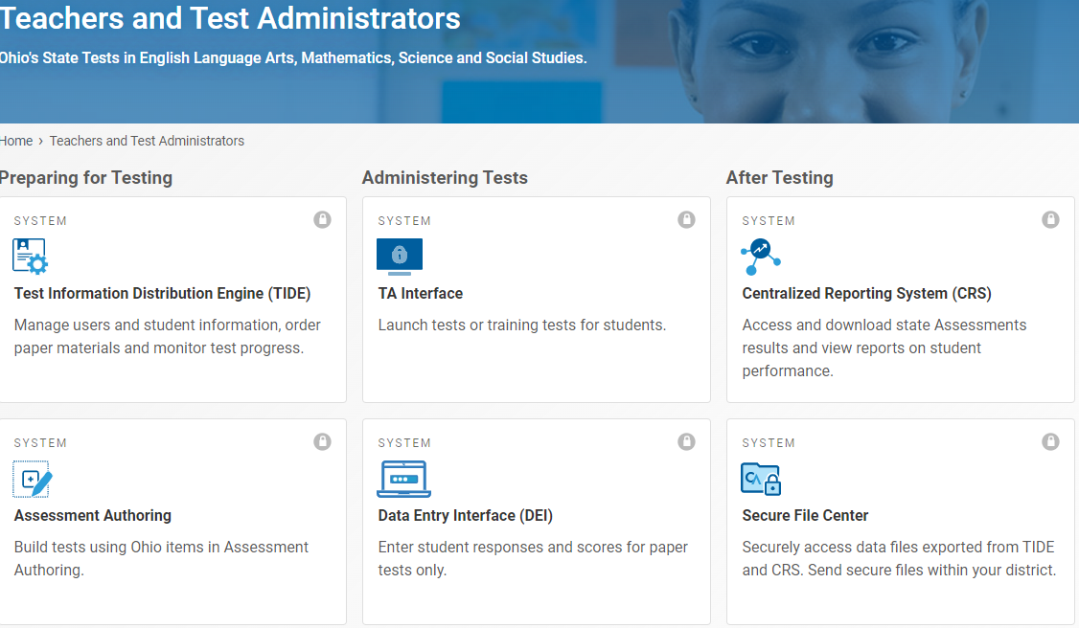
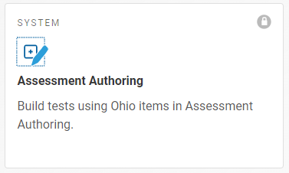
Assessment Authoring System
The new system is accessed from the same location as other CAI systems, e.g., TIDE, the TA interface, CRS. A new card will be added to the portal to access the new system.
Once tests are built and published, the custom tests are administered and reported using the same systems as the summative assessments.

Slide 4
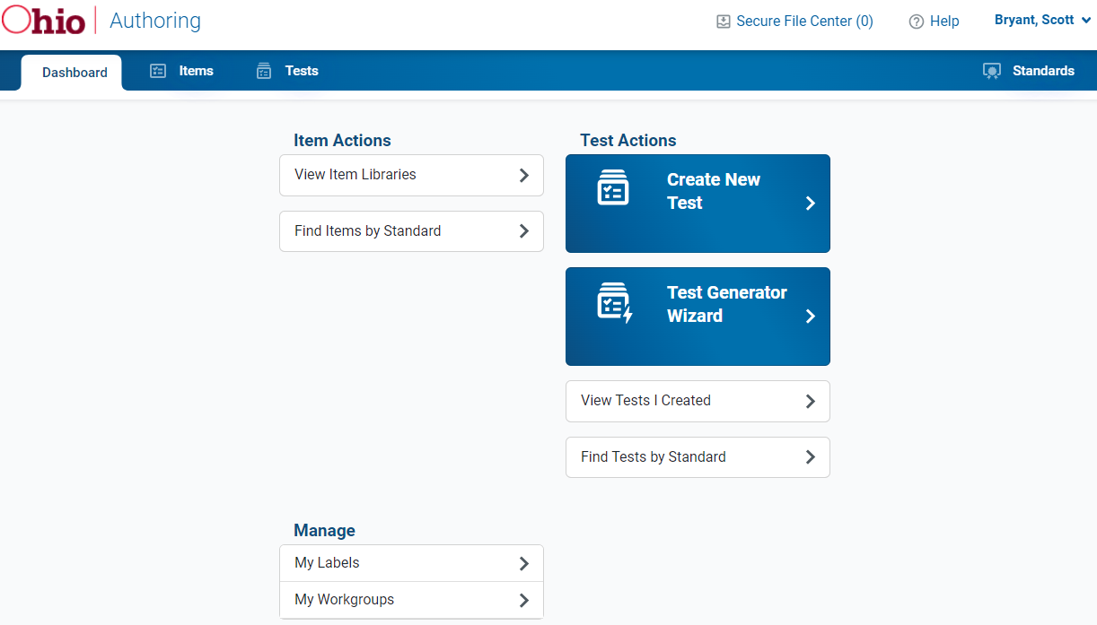
Assessment Authoring System
In the system, you can view the items that are loaded in the system using the View Item Libraries button.
You can use the Tests tab to create custom tests by searching for items to add, or use the test generator wizard to set some parameters to automatically generate a test. E.g., subject, grade, standards, number of items.

Slide 5
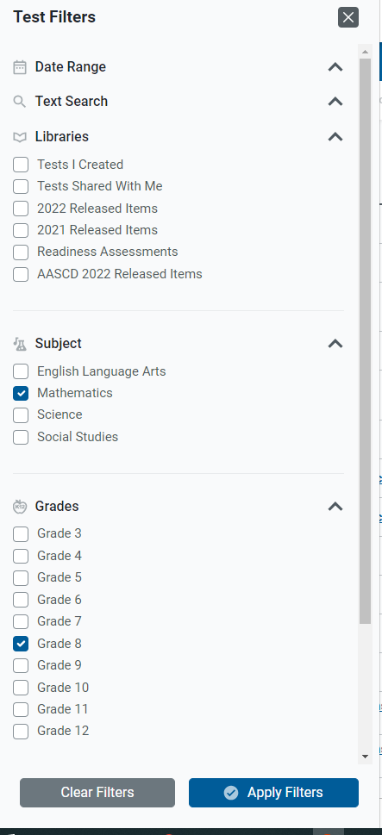
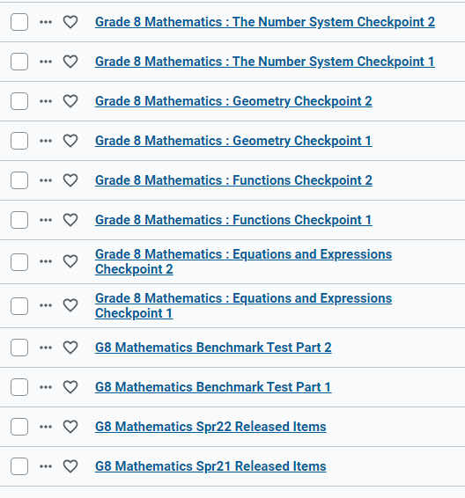
Assessment Authoring System
All of the benchmark and checkpoint tests are pre-loaded in the assessment authoring system, so you can view the items before administering them to your students. You can also add or remove items to them.

Slide 6
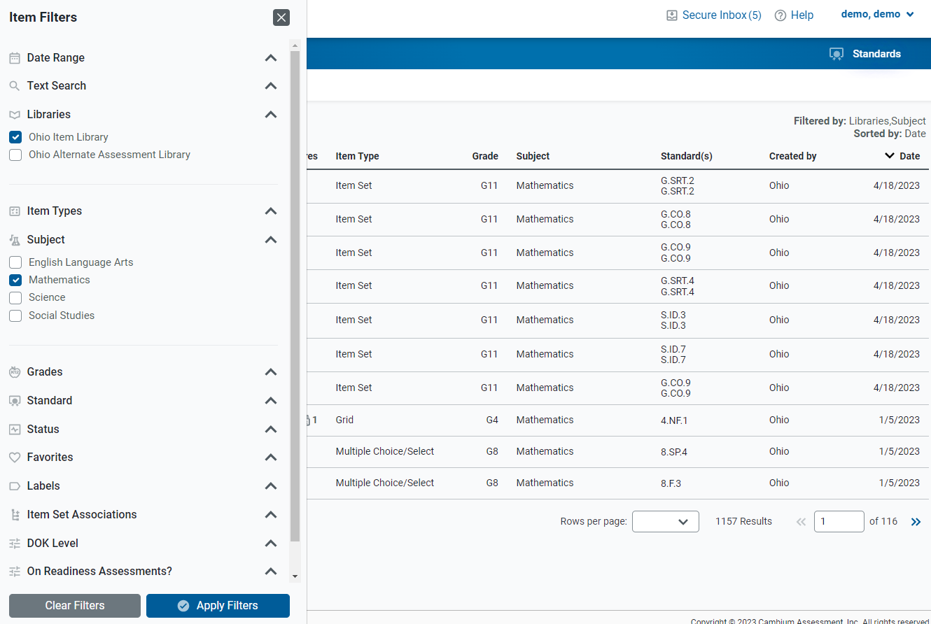
Assessment Authoring System
The item libraries tab allows you to use various filters to find items you may want to use on a test.
From this tab, you can favorite items, or create custom labels to help identify them when you are creating a test.

Slide 7
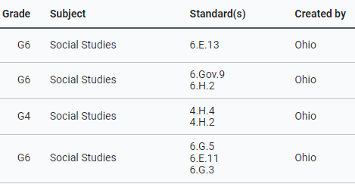
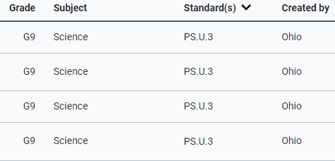
Assessment Authoring System
Authoring includes all Grades 4 and 6 Social Studies items as well as all high school physical science items

Slide 8
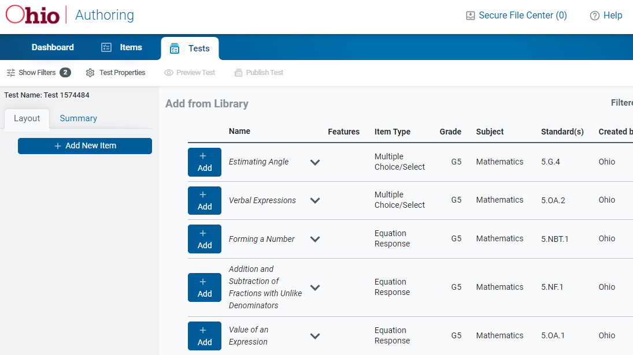
Assessment Authoring System
From the tests tab, after clicking on Create New Test, the same search filters appear to find items to add to a test.
Add as many items as you want to the test, then click Publish Test to make this new test available to assign to students in the TA interface.

Slide 9
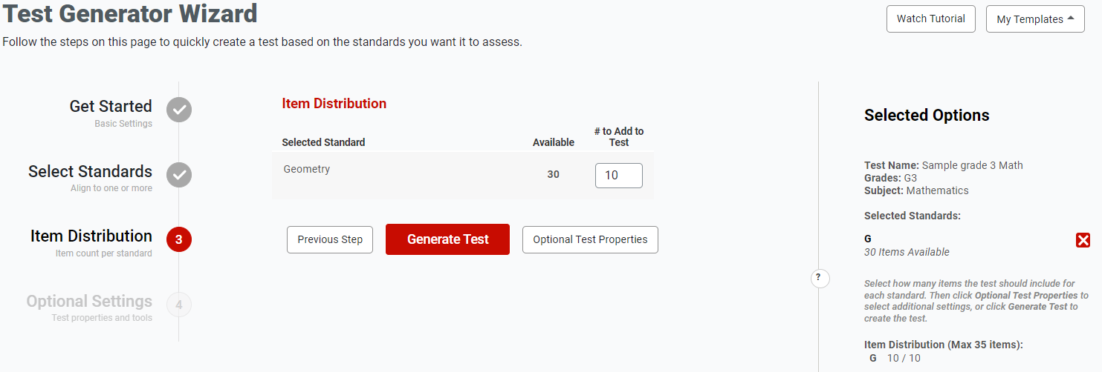
Assessment Authoring System
Use the test generator wizard by first setting basic settings: test name, grade, subject.
Then select the content standards for the test. You can align to a reporting category or individual standards.
In the example in the screenshot, I have selected grade 3 math, geometry reporting category. There are 30 items available to add to a 10-item test

Slide 10
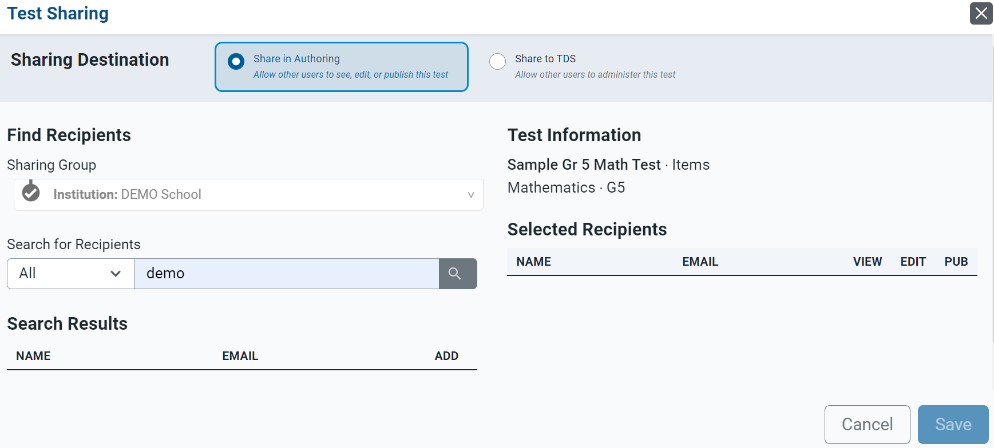
Assessment Authoring System
Teachers will also have the ability to collaborate in creating and sharing assessments for use
District-level users will also be able to create tests and share these tests with their teachers

Slide 11
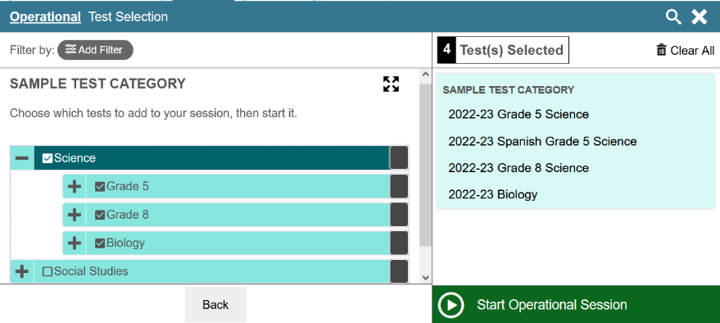
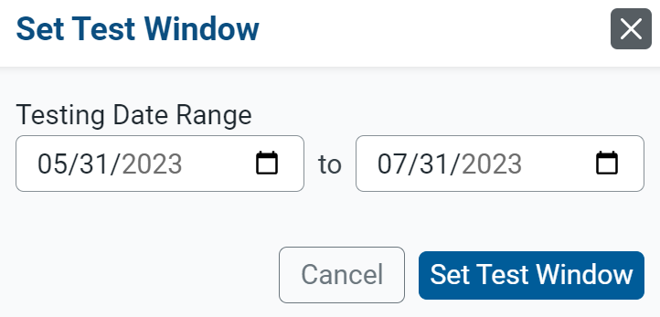
Assessment Authoring System
Once a test is published, it will be available for the test administrator to choose in the Test Administrator Interface.
Depending on the user role, test windows can also be established for tests

Slide 12
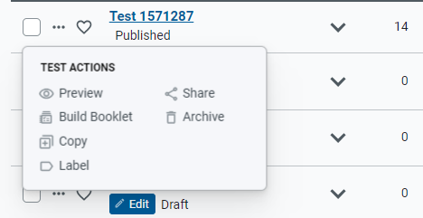
Assessment Authoring System
Tests can also be printed into booklets
Allows for printing of student booklets and teacher booklets which include scoring guides (all items hand-scored)

Slide 13
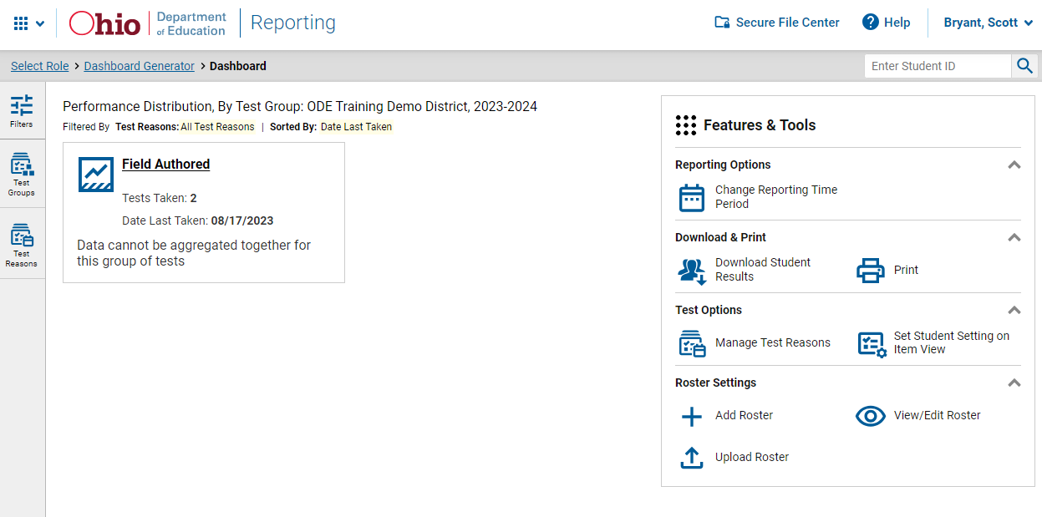
Assessment Authoring System
Test scores will be reported into the Centralized Reporting System as with all other state tests

Slide 14
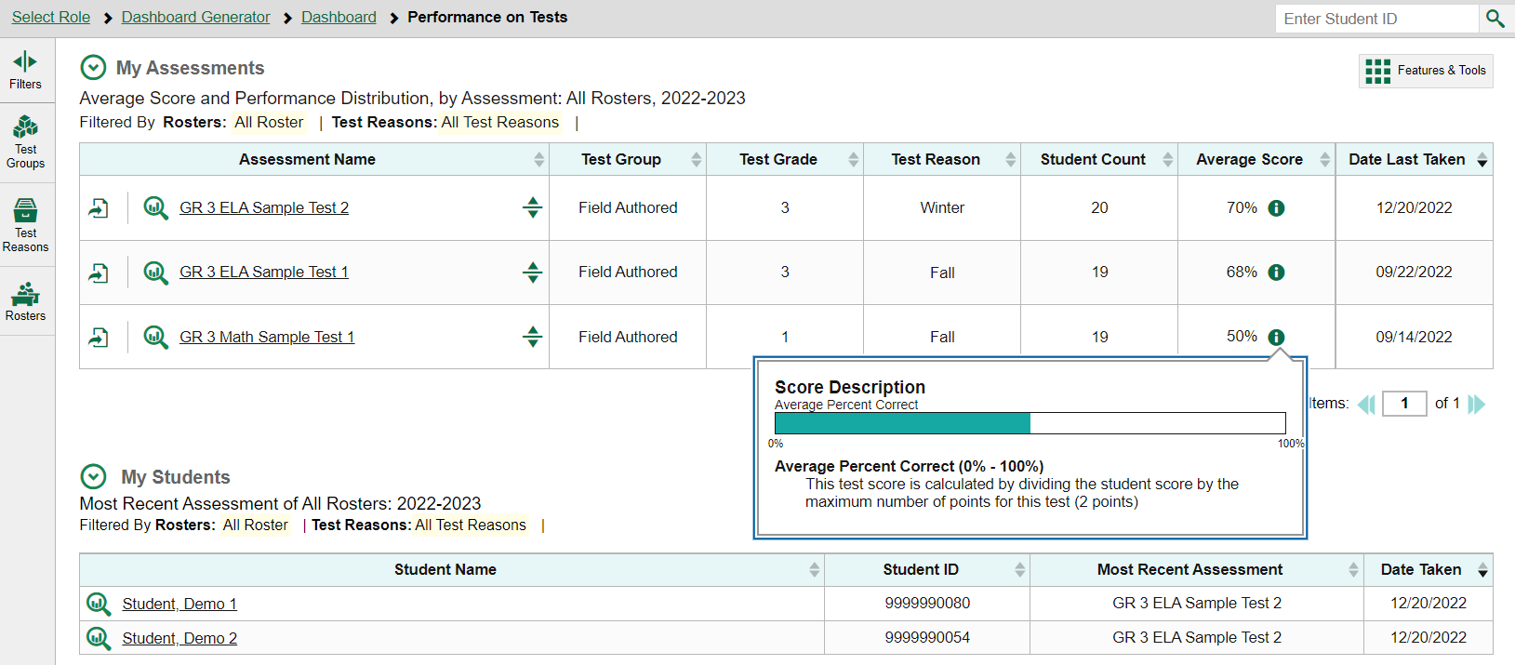
Assessment Authoring System
Teacher-Authored
Teacher-Authored
Teacher-Authored

Slide 15
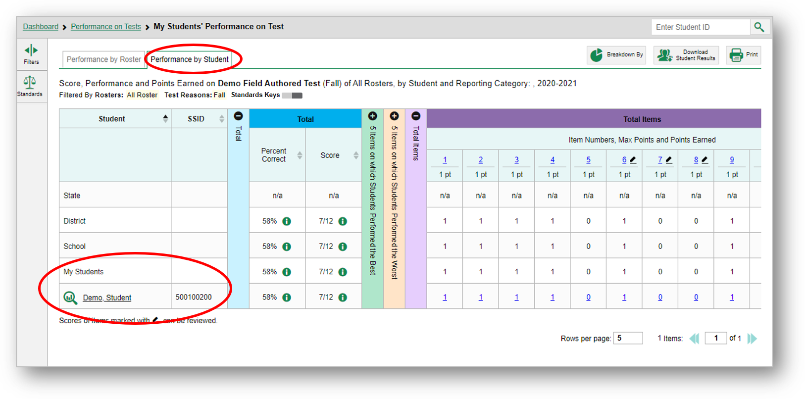
Assessment Authoring System

Slide 16
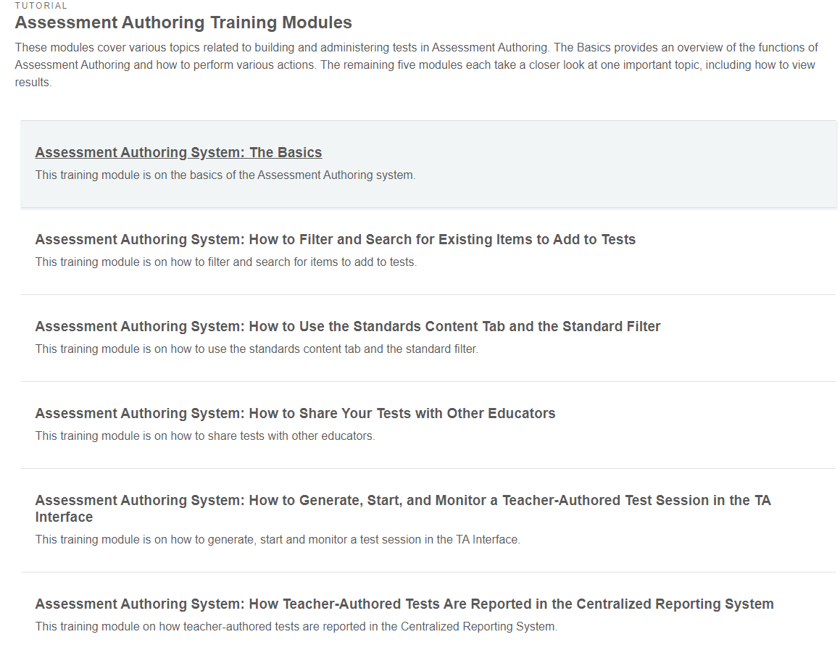
Assessment Authoring System
Assessment Authoring Resources now available at:
https://oh-ost.portal.cambiumast.com/resources/online-systems-resources/assessment-authoring

Slide 17
Demonstration
https://authoring.cambiumast.com

Slide 18
Questions?

Slide 19
@OHEducation Scott.Bryant@education.ohio.gov 614-728-7121

