Slide 1
Career Awareness and Exploration Funds Professional Development Workshop
November 30, 2021 11:00am – 2:00 pm

Slide 2
Todays Agenda:
Introductions
Overview of Funds Processes and Uses
Emerging Promising Practices from CTPD Leaders
Discussion Guide Overview
Q&A Session
Next Steps
Career Awareness & Exploration
Design Time – Local Teams
Notes:
Q&A: https://jamboard.google.com/d/1HtVFmTqP6fJUmrl-7CwfVO3RGCoT8hKaxWpv0kgjryc/viewer?f=1

Slide 3
Overview of Funds Processes and Uses
Aaron Rausch
Director
Office of Budget and School Funding
Notes:
The estimates for each CTPD and school districts were emailed out to CTPD leads.

Slide 4
Career Exploration and Awareness Funds
Purpose of Funds
Allocated Amounts
Sequence of Payment and Plans
State Support Opportunities
Questions

Slide 5
Purpose of Funds
1
2
3
Career awareness programs to students in K-12
Curriculum to students
Assistance to teachers in providing career development

Slide 6
Purpose of Funds
4
5
Development of a career development plan for each student
Opportunities for students to engage in career-focused
activities

Slide 7
Allocated Amounts
Year 1 = $2.50/student (K-12)
Year 2 = $5.00/student (K-12)
Notes:
[When presenting, this slide requires multiple clicks to reveal each element]

Slide 8
Sequence of Payments
CTPD works
with schools to make plans
ODE transfer funds to CTPD lead
All schools generate
funds

Slide 9
System Examples
Hire a career advisor
Identify Career Readiness Leader contacts in each building of the CTPD
Real World Learning/Partnership Coordinator
Fund career fairs, field trips, speakers, professional development

Slide 10
Emerging Promising Practices from CTPD Leaders
Rick Smith – Elementary School Examples
Brian Bontempo – Middle School Examples
Joe Glavan – High School Examples

Slide 11
Elementary Ideas
Align ideas to the grade level curriculum to apply real world activities to lessons already presented in schools.
We believe some activities are in person and some can be done virtually with multiple classrooms at one time.
OHP Activities in Development
Mini Manufacturing Day at Elementary Schools
Use riveter, air brakes, virtual welder, electrical demonstration
Virtual Cooking Show – Groups Across CTPDs at One Time
Health Academy
a. CPR for Kids
b. Black Light Germ Activity
c. First Aid Problem Solving
d. Exercise Science - Lead classroom workout and show them how to take a pulse
Elementary spa and hair style demonstration
Business – Soft Skills Demonstration, Innovative Challenges, Counting/Making Money
Construction – Build bird houses with all county schools in a park
Culinary – No bake activity in a box
For all these activities, there will be a follow-up TFS Career Tree handout to show students the multiple pathways these types of hands-on career paths could lead to providing a vision and a dream.

Slide 12
Middle School Ideas
Designated Point of Contact for Career Development at the Middle School
Partner with large employers to develop series of tours to explore & learn about careers in demand careers in our area
Connect curriculum in academic areas to micro credentials
Examples:
Tape/Rule - 1st part of Precision Measurement (Snap-On Tools) - 7th Grade
Torque (Snap-On Tools)
Multimeter - State approved Industry Credential (Snap-On Tools) - 8th Grade
CPR/First Aid (abbreviated version) - 6th Grade
Robotics

Slide 13
Middle School Ideas
Use ODE approved credential list or create own “in house” certificate to connect curriculum to micro credential to careers
Identify “traveling teacher” to go to schools - CTE, School Counselor, Career Development Coordinator, Industry Partner, etc.
Work with Point of Contact and classroom teacher to coordinate
Work with vendor to purchase instructional sets
Develop local business partners to speak to students, help purchase tools, etc.
Use local high School CTE Students to assist in class events
Discuss where these skills transfer in careers
Create Certificates of Completion, signed off by district, CTE and industry partner

Slide 15
Career Awareness and Exploration Funds High School
Exploration
Experience
Engagement

Slide 16
Exploration
Ohio Means Jobs
Naviance
Transeo
VirtualJobShadow

Slide 18
Experience (Work-Based Learning Coordinator)
Guided Tours
Job Shadows
Internships
Senior Project

Slide 19
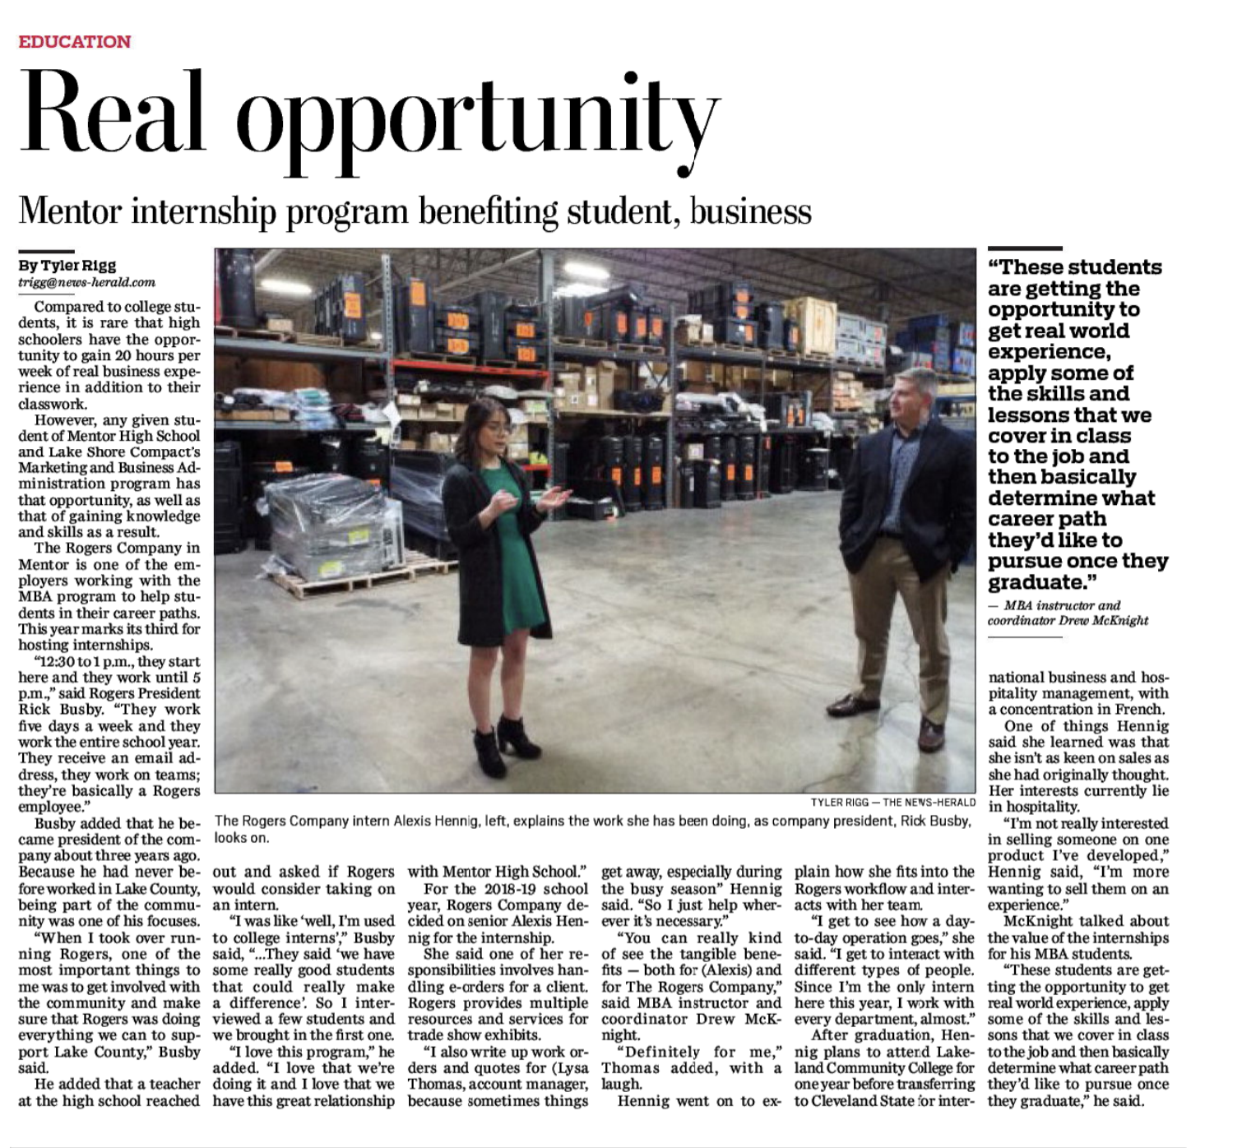

Slide 20
Engagement
Career Expo
Industry Credentials
Real World Learning Project Based Learning

Slide 21
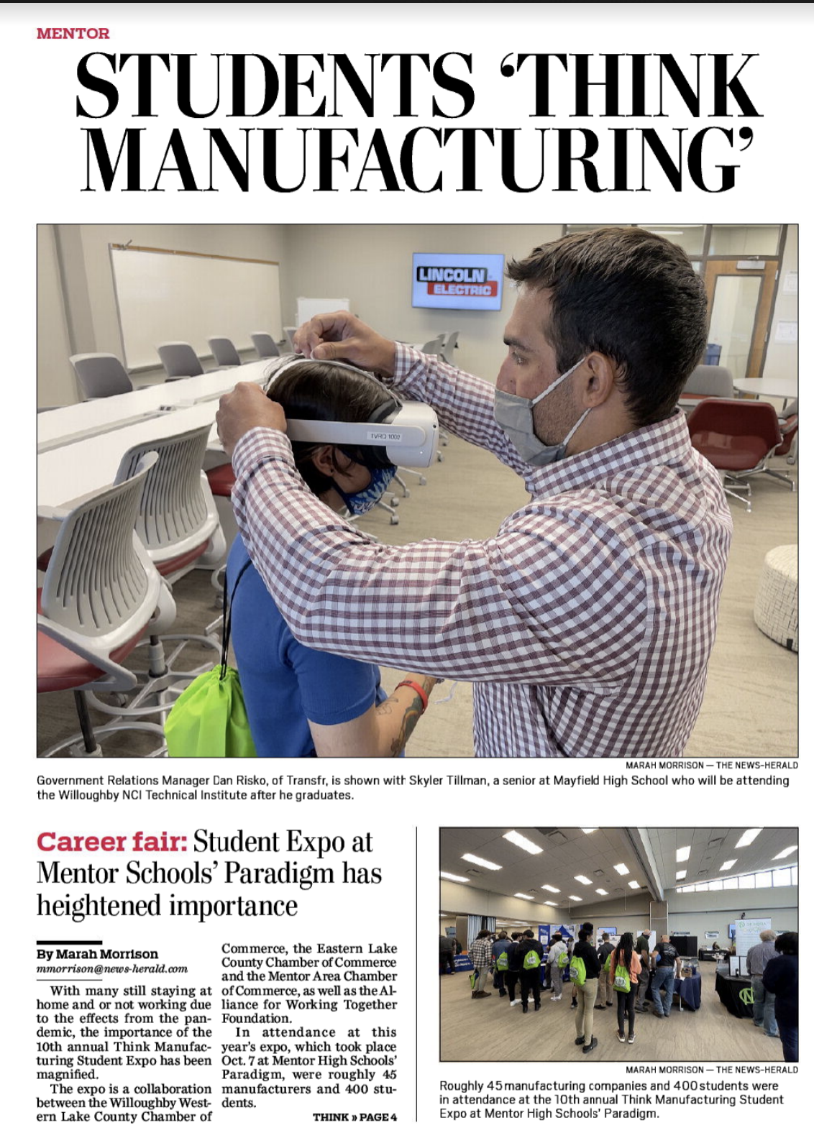
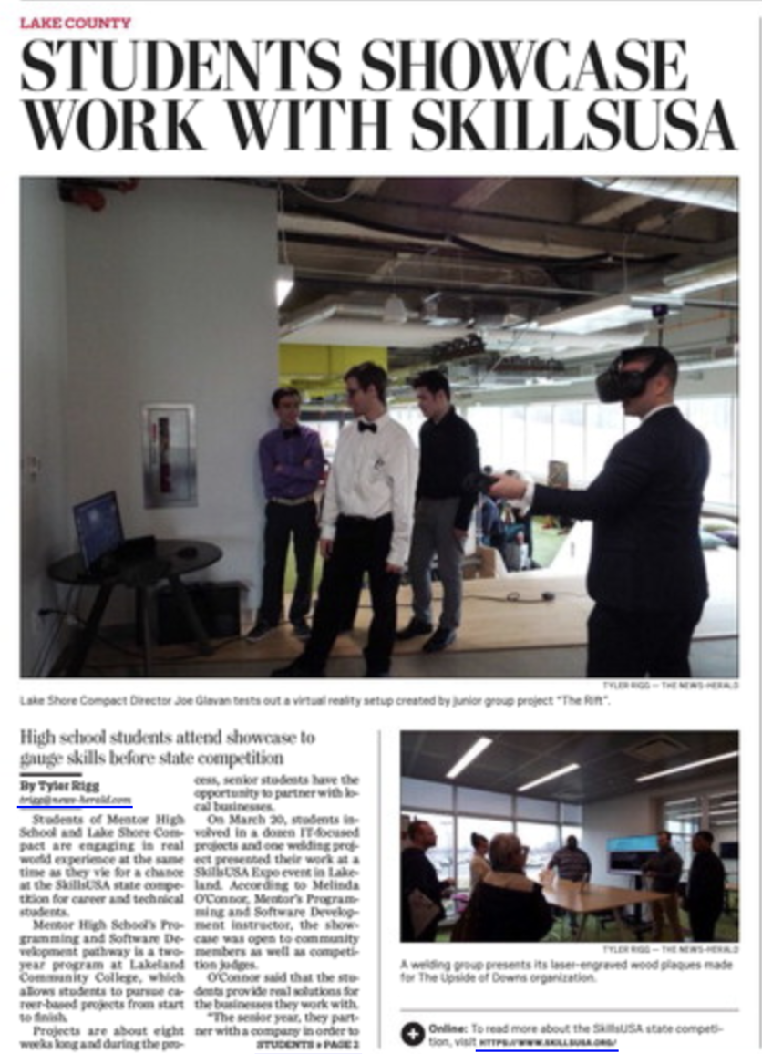

Slide 23
Discussion Guide Walk-through

Slide 24
Q & A
Notes:
https://jamboard.google.com/d/1HtVFmTqP6fJUmrl-7CwfVO3RGCoT8hKaxWpv0kgjryc/viewer?f=1

Slide 25
Next Steps
ADDITIONAL SESSION OPPORTUNITY:
November 30th 11:00a - 2:00p
OPEN Q&A and IDEA SHARING:
December 15th - 12:00 pm - 2:00 pm
January 25th - 11:00 am - 1:00 pm

Slide 26
Local Design Time

Slide 27
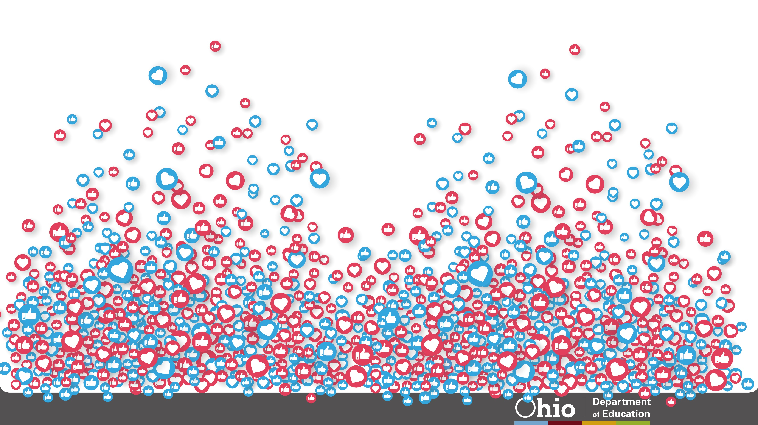
@OHEducation

Slide 28
Bullet Template
Sample Text Sample Text
Sample Text Sample Text
Sample Text Sample Text
Notes:
[When presenting, this slide requires multiple clicks to reveal each element]

Slide 29
Line Template
Text Line 1
Text Line 2
Text Line 3
Text Line 4

Slide 30
Shape Template
Share key points
Streamline your message
Underscore major takeaways

Slide 31
Sample Text
Sample Text
Sample Text
Sample Text

Slide 32
Sample Text
Sample Text
Sample Text
Sample Text

Slide 33
Here are some ideas to showcase sequences and events.
Basic font sizes
Bullet points, lines and shapes
Sequences and timelines
Images and text
Numbers

Slide 34
Step One
Additional Details
Additional Details
Additional Details
Sample Question or Process Statement
Step Two
Additional Details
Additional Details
Additional Details
Step Three
Additional Details
Additional Details
Additional Details
Notes:
[When presenting, this slide requires multiple clicks to reveal each element]

Slide 35
Sample Timeline
Date:
Event Text
Date:
Event Text
Date:
Event Text
Date:
Event Text
Date:
Event Text
Date:
Event Text

Slide 36
Sample Timeline
Future
Years
Year
Two
Year One

Slide 37
Images accompany the key messages in the next set of slides.
Basic font sizes
Bullet points, lines and shapes
Sequences and timelines
Images and text
Numbers

Slide 38
Sample Text
Sample Text
Sample Text
Sample Text

Slide 39
Sample Text
Sample Text
Sample Text
Sample Text

Slide 40
Sample Text
Sample Text
Sample Text
Sample Text

Slide 41
Sample Text
Sample Text
Sample Text

Slide 42
Sample Text
Sample Text
Sample Text
Sample Text

Slide 43
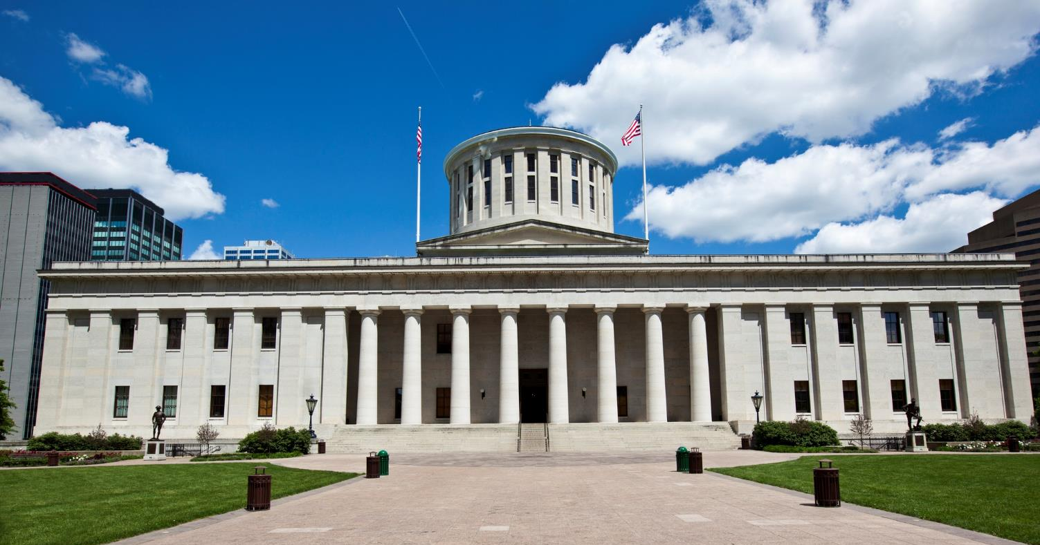
Comparing Items
Item One
Item Two
Sample Text Sample Text
Sample Text
Sample Text Sample Text
Sample Text

Slide 44
Here are some templates with numeric sequences.
Basic font sizes
Bullet points, lines and shapes
Sequences and timelines
Images and text
Numbers

Slide 45
Number Template
1
Sample text sample text sample text
Sample text sample text sample text
Sample text sample text sample text

Slide 46
Number Template
2
Sample text sample text sample text
Sample text sample text sample text
Sample text sample text sample text

Slide 47
Number Template
3
Sample text sample text sample text
Sample text sample text sample text
Sample text sample text sample text

Slide 49
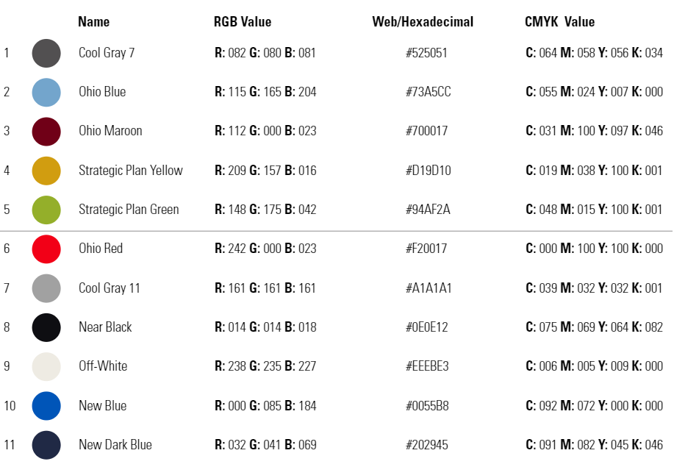
Core colors
Complimentary colors

Slide 50
Number Template
Sample text sample text sample text
Sample text sample text sample text
Sample text sample text sample text
1
2

Slide 51
Number Template
Sample text sample text sample text
Sample text sample text sample text
Sample text sample text sample text
3
4

Slide 52
Number Template
1
2
3
Sample text
Sample text
Sample text

Slide 53
Share your learning community with us!
#MyOhioClassroom
Celebrate educators!
#OhioLovesTeachers

