Slide 1
Business Advisory Council
Plan Development Workshop

Slide 2
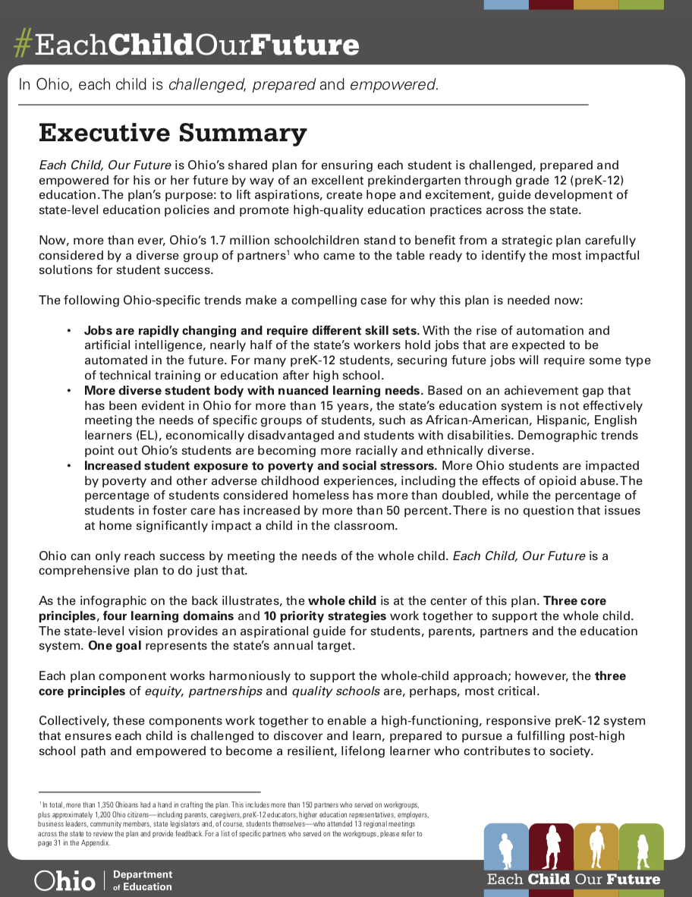
Jobs are rapidly changing and require different skill sets.
With the rise of automation and artificial intelligence, nearly half of the state’s workers hold jobs that are expected to be automated in the future. For many preK-12 students, securing future jobs will require some type of technical training or education after high school.

Slide 5
Introductions
Tell us your name, which organization you are with and where you are from!
Intended outcome: To foster collaboration among councils and organizations.

Slide 6
Business Advisory Councils Overview
Ohio Department of Education staff will identify where to find information related to Business Advisory Councils and highlight key areas of expected work.
Intended outcome: This will allow leaders to ask clarifying questions about policy. We will also reemphasize the importance of this work.

Slide 7
Background and Requirements
Councils originally established in Ohio law
Law requires all districts to have a council
A district may leverage an ESC’s council

Slide 8
Responsibilities
Employment skills and curriculum
Changes in economy, job market, employment and future jobs
Relationships among businesses, labor organizations and education
Notes:
Responsibilities (ORC 3313.82)

Slide 9
Implementation Timeline
Date: 6/30/18
Districts establish Business Advisory Councils
Date: 3/1/19
Publish joint statement
Date: 12/31/17
Publish operating standards to districts
Date: 9/30/18
Develop and submit council plan to the Department
…then revisit annually

Slide 10
Business Advisory Council Highlight
Amy Wood – Tiffin City Schools
Intended outcome: Hear from a Business Advisory Council that has yielded great results for students and schools. Ask questions about how they did it!

Slide 11
Joint Statement Inventory
http://www.wcsrams.org/Downloads/BAC_2019-Joint-Statement_FINAL.pdf
http://www.geaugaesc.org/Downloads/Joint%20Statement2.docx
https://www.goshenlocalschools.org/apps/pages/index.jsp?uREC_ID=287280&type=d&pREC_ID=1651804
http://www.westholmes.k12.oh.us/pages/family%20resource/standards%20brochures/BAC%20Joint%20Statement%202019.pdf
http://www.edisonchargers.org/Downloads/Business%20Advisory%20Council%202019%20Joint%20Statement.pdf
http://www.miamitrace.k12.oh.us/Downloads/Clinton-Fayette%20County%20Business%20Advisory%20Council%20Joint%20Statement%20March%202019.pdf
http://www.cvul.org/Downloads/Joint%20Statement%20Business%20Advisory%20Council%20Plan4.pdf
http://filecabinet.eschoolview.com/9E9F0E21-A507-46BC-B602-459032268657/ESCNEOBACJointStatement2_21_19.pdf
https://www.hcesc.org/wp-content/uploads/2019/02/HCESC-BAC-Joint-Statement-March-2019-002.pdf
http://www.esclakeeriewest.org/Downloads/ESCLEW%20BAC%20JOINT%20STATEMENT.pdf
https://www.wadsworth.k12.oh.us/Content/businessadvisorycouncil

Slide 12
Facilitated Discussion on Activities and Programs
Share out:
What is your meeting structure and how do you make them meaningful?
What has been your most successful activity as a Business Advisory Council?
What activities have you seen others in your area host or facilitate?
Intended outcome: Come prepared to share the most promising practices. Listen for other great ideas to try.

Slide 13
Plan Overview and Development
Ohio Department of Education staff will discuss the newly developed plan template. The Department will guide leaders through a discussion on completing goals and action steps relating to the key functions of a Business Advisory Council.
Intended outcome: Leaders will be given time to address their own council’s goals.

Slide 14
Mission
Develop a mission statement or purpose that reflects the goal-oriented direction of the council and how it will support stronger connections between business and schools to enhance the performance of students.
1

Slide 15
Membership
Identify the composition of the business advisory council.
Identify industry representation, including economic and workforce development partners participating in the council. If this is an educational service center-supported business advisory council, list supported districts.
2

Slide 16
Other Resources:
Build your coalition.

Slide 17
Schedule of Meetings
The Business Advisory Council meets quarterly or more.
Consider scheduling meetings at a convenient time for industry partners.
Consider how you plan and structure your meetings in order to accomplish the outlined responsibilities.
3

Slide 18
Responsibilities
Describe the responsibilities of the business advisory council, as agreed upon with the district or ESC governing board. There are four major areas of responsibility outlined by state law.
4

Slide 19
Responsibilities
Delineation of Employment Skills
Development of a Curriculum to Instill Employment Skills
Address Changes in the Economy, Job Market and Future Job Availability
Develop and sustain relationships among the business community, labor organizations and education personnel in the areas it represents
4

Slide 20
Feedback and Next Steps
Polling App Questions:
Go to PollEv.com/cpalsgrove716
Intended outcome: Attendees will identify what type of state support they would like to have as leaders of Business Advisory Councils over the coming school year and
beyond.

Slide 21
Other Resources:
Community College Advisory Board
ODE Stakeholder Engagement Toolkit
Career-tech Industry Advisory Committee

Slide 22
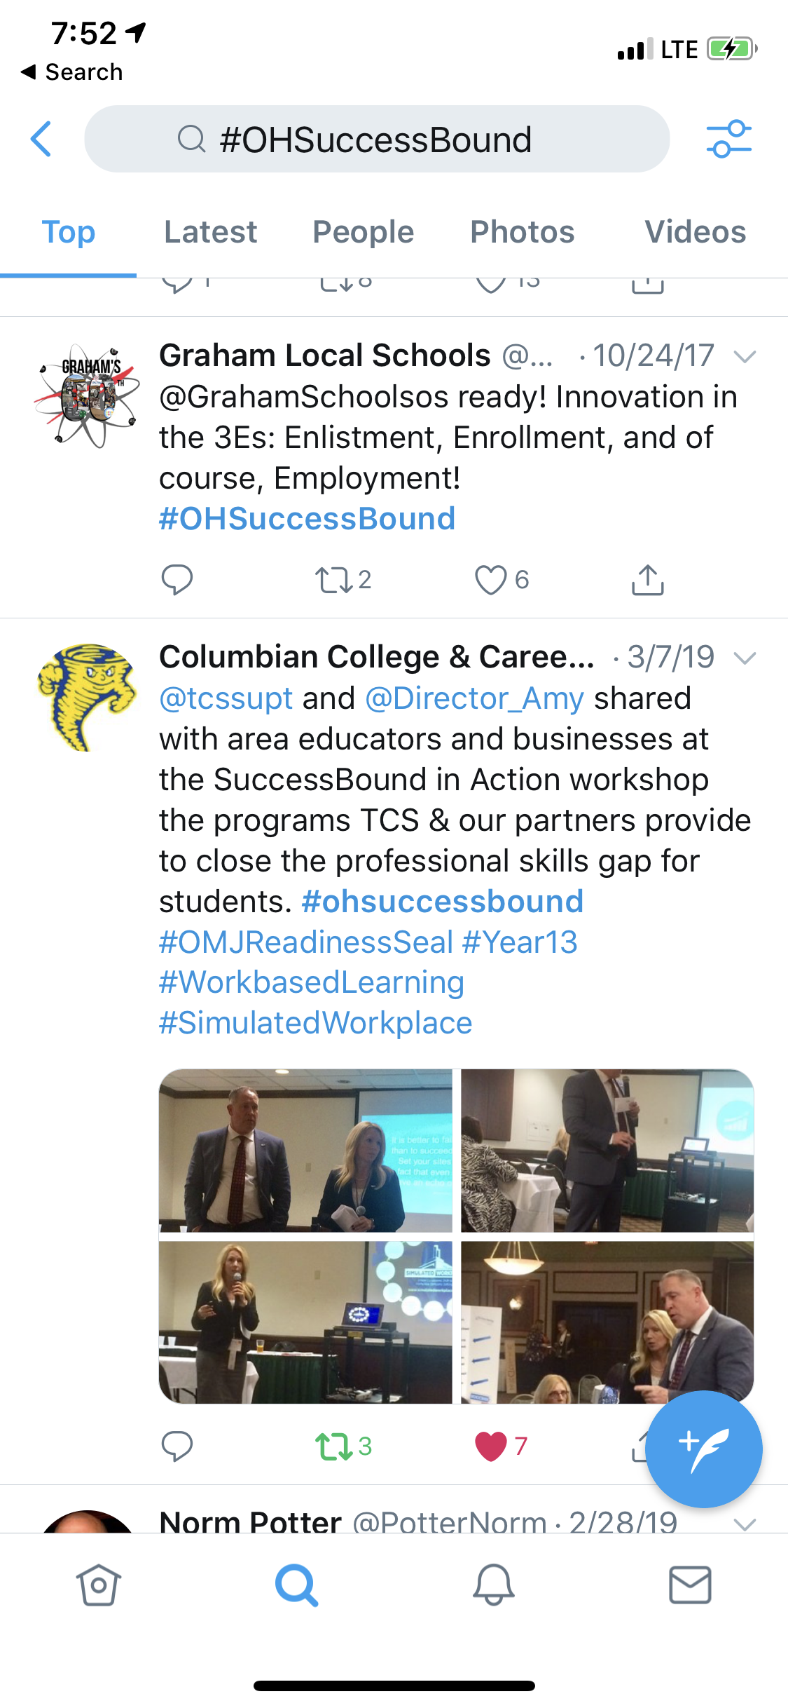
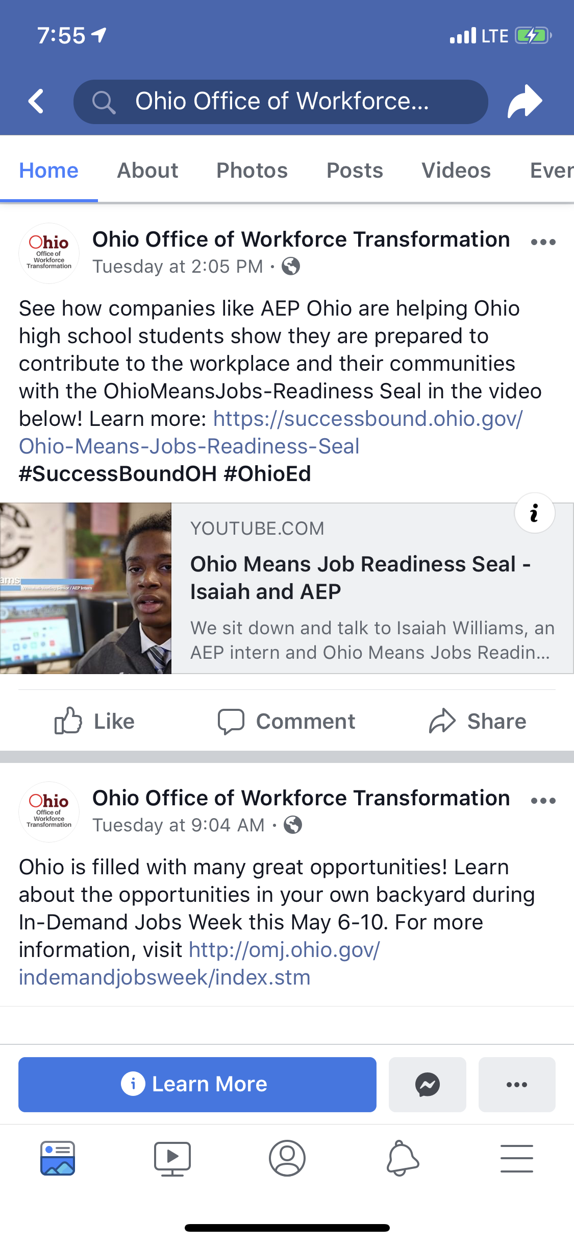
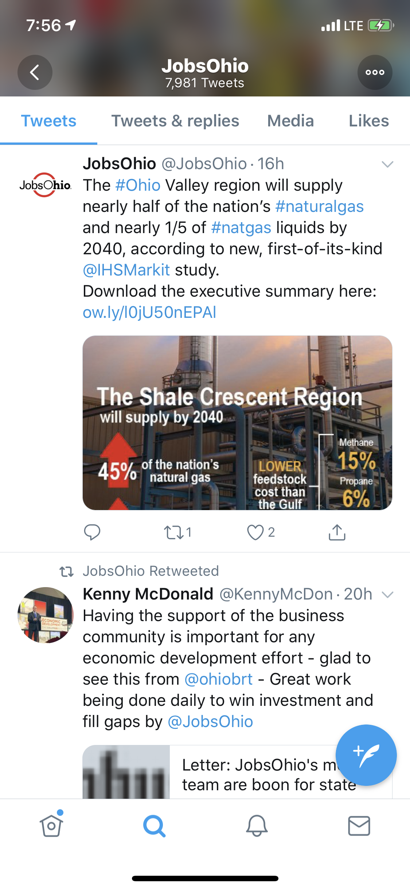
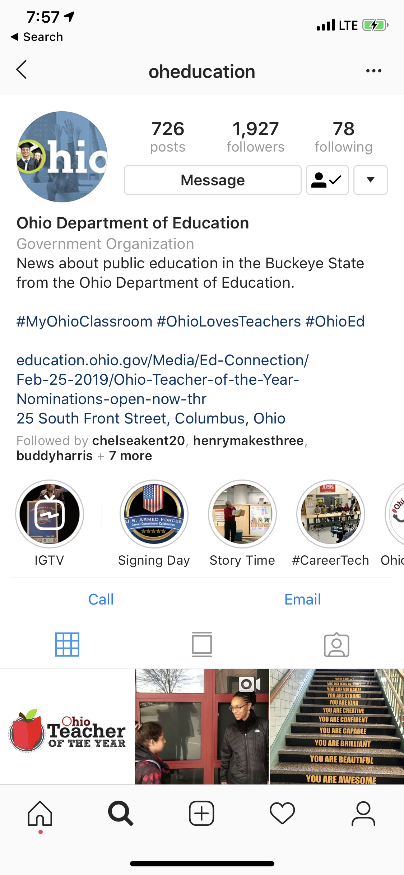
Get connected: #OHSuccessBound #CareerTechOhio #EachChildOurFuture

Slide 23
Thank you!

